Slide 1

Design Innovation Summer Award (DISA) 2019
Fail Tolerant Drone
Applicants : Shashank Dammalapati K.R.V. Vamsi Krishna Nagendra Kokku
2017ME10572 2017MT60777 2017CS10343
Facilitator : Dr. Amit Gupta, Dept of Mechanical Engineering, IIT-Delhi.

Slide 2
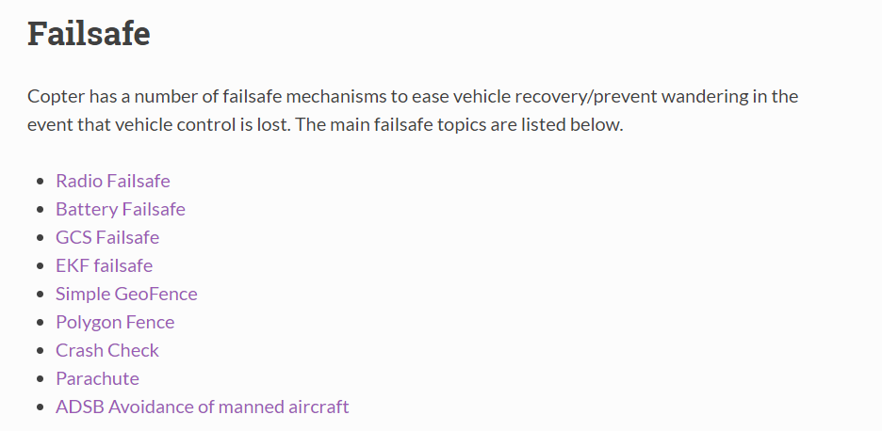
Pixhawk (Contains all sensors), Open Source hardware
In Aeromodelling club we work on Ardupilot, a open source software for drones,
helicopters and rovers.
Main Features : Mission planning, different flying modes including a fail safe mode.

Slide 3
Propeller failures
Complete breakage
Symmetric breakage
Asymmetric breakage
Algorithms to fail safe in case of Complete breakage or in case of a motor shut down.
Project implementation
Detection of the propeller failure.
Stabilizing the drone by switching off the opposite motor.
Safely Landing or bringing back the drone using cyclic instructions.

Slide 4
Prior work
We worked with Pixhawk hardware and Ardupilot software in Aeromodelling club
We experimented with different fail safe modes that are available in Ardupilot software like
1. Battery fail safe mode
2. Geo-fencing mode
We also made different RC planes including Pusher, Puller and Delta wings in Aeromodelling club,
And have experience in flying planes and drones.
Achievements
We secured 1st prize in Boeing National Aeromodelling Competition that was held in Madras
by designing a plane that can lift heavy payloads.

Slide 5
Deliverables
We will be able to safely land/ hover a drone which had a propeller/Motor failure flying in the mid air
We will also be able to move the drone after the failure to bring it back to the launch pad.
Budget
Pixhawk flight controller | 7000/-
GPS and compass module | 2200/-
Raspberry pi | 3000/-
Framework, Motors, ESC, Propellers, wires etc | 5600/-
Gyroscope/Accelerometers and other sensors | 3000/-
Total | 20800/-

Slide 6
GANTT Chart
Task | Week 1 | Week 2 | Week 3 | Week 4 | Week 5 | Week 6 | Week 7 | Week 8
Literature review/Hardware collection
Building/Algorithms for detecting and stabilizing after failure
Algorithms for moving the damaged drone with two propellers
Testing and Refining

Slide 7
Thank you

